Slide 1
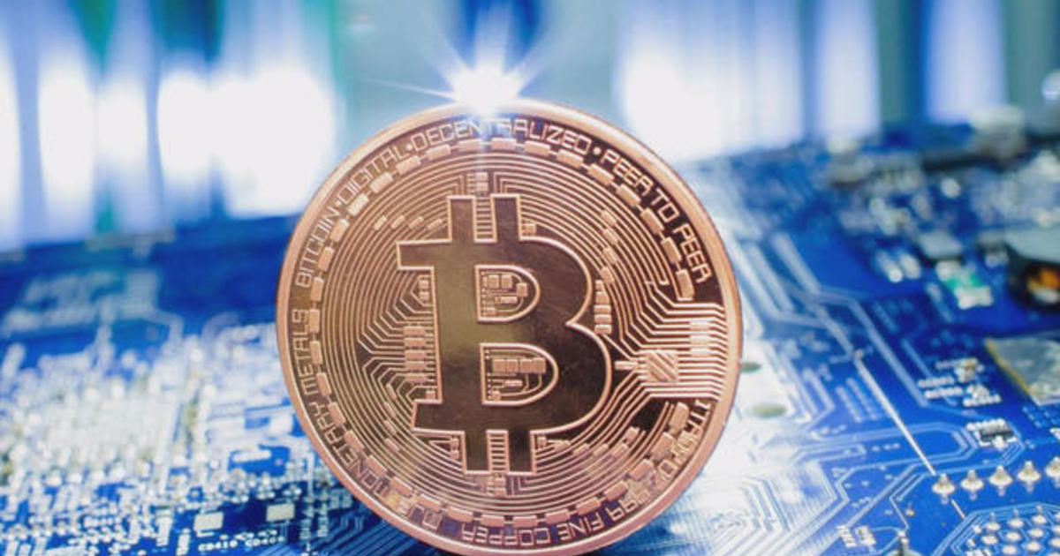



CRYPTOCURRENCIES INVESTIGATION REPORT
Module Leader: [REDACTED]
Blockchain Anatomy and Analytics
CST4220

Slide 2
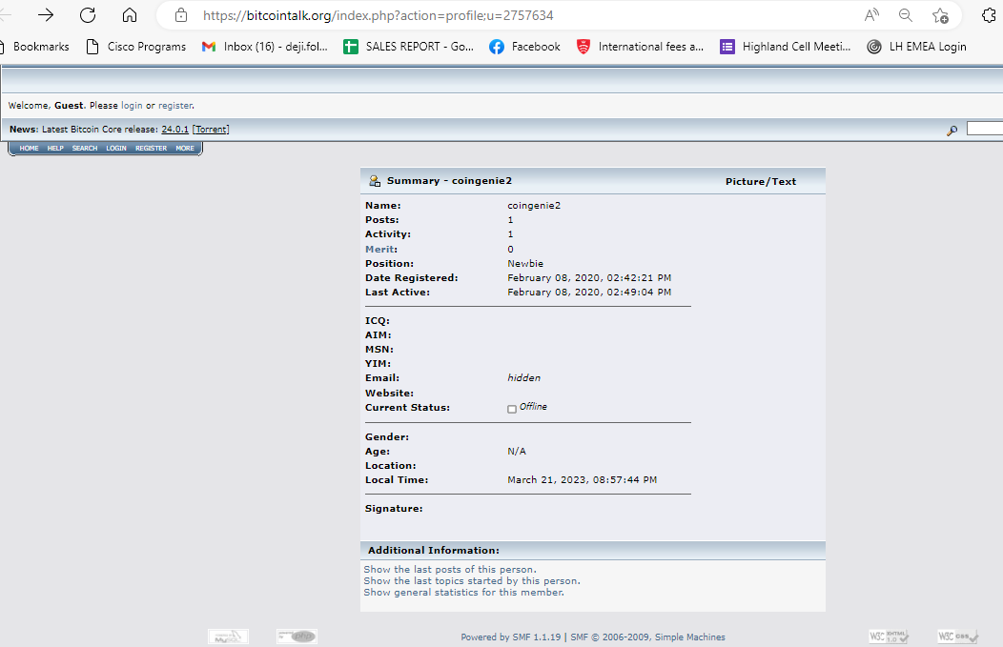
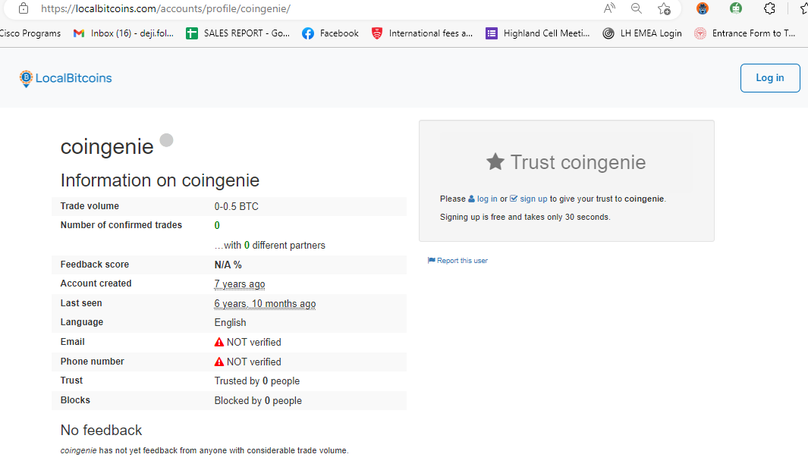
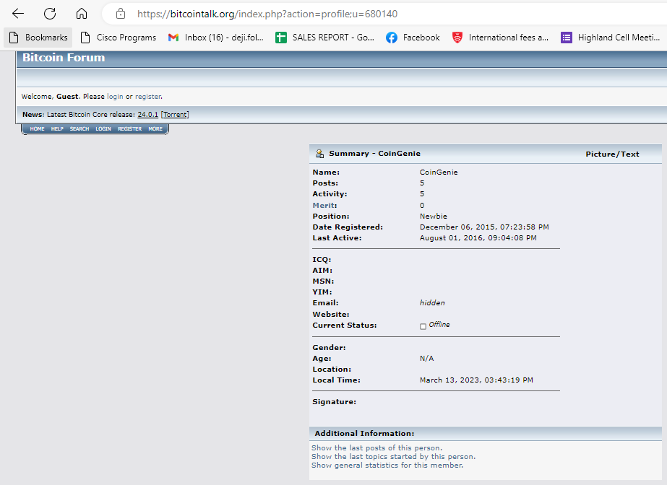
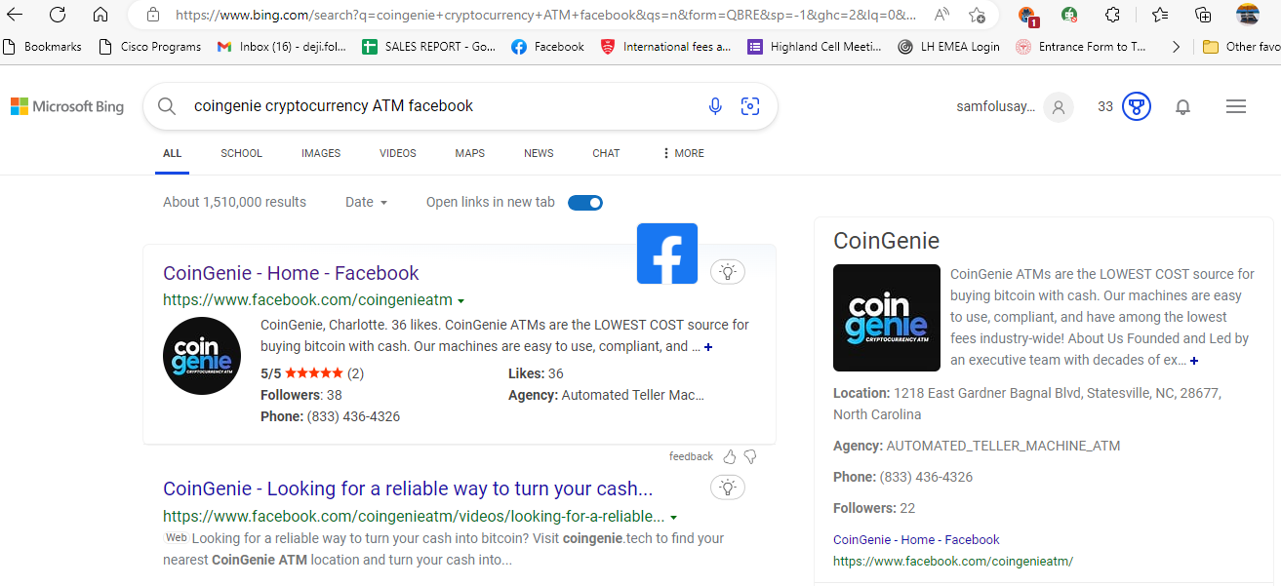
THE CODED NAME COINGENIE
The case started with the registration of a coded named Coingenie on bitcointalk.org on December 06, 2015, with five posts and a last active date on August 01, 2016.
Coingenie 2 from bing.com with just one post.
A Facebook account called Coingenie cryptocurrency ATM and a localbitcoin.com account with no further information.

Slide 3
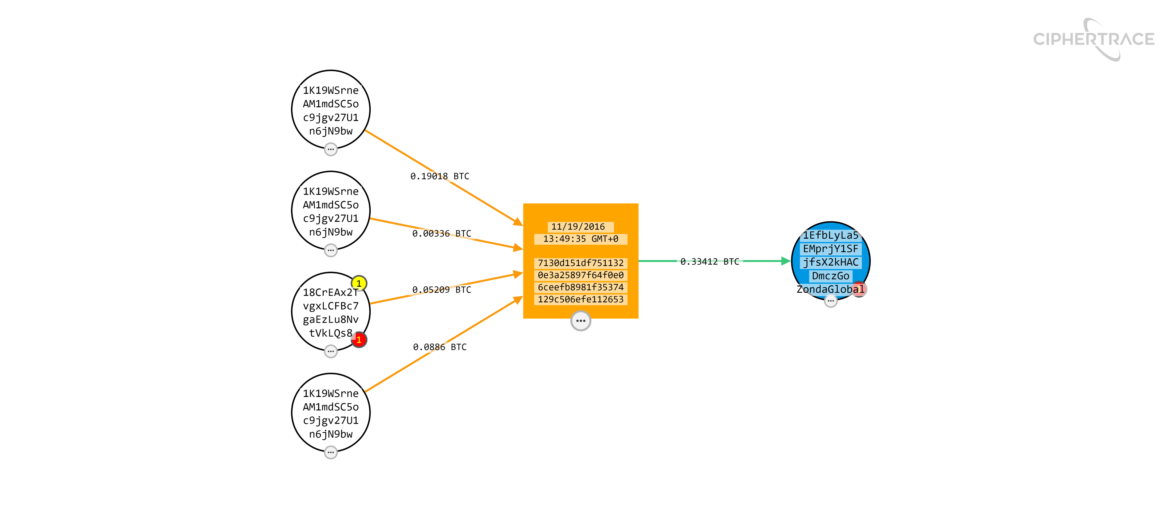
LAST TRANSACTION
Bitcoin address of 18CrEAx2T and 1K19WSrn combinedly transferred 0.33412 BTC to 1EfbLyLa which belong to Zonda Global exchange in ESTONIA on 19th November 2016.

Slide 4
BACKGROUND TO THE INVESTIGATION
The suspect, Jean was arrested by the Law enforcement
Four Bitcoins Addresses allegedly connected to Jean
.
7v6yjcmqem3jkjj2.onion from Paper evidence left in Police Post Box by unidentified person.

Slide 5
HARDWARE AND SOFTWARE DEVICE FOR THE INVESTIGATION
contemporaneous notes were kept necessitating another investigator(s) to arrive at the same conclusion if the same process is followed (Williams, 2012).
An external hard drive was used for the purpose of duplicating collected data and managing the chain of custody (Wikipedia, 2023).
A laptop was used throughout the digital forensic investigation to browse and access the relevant OSINT used for this exercise.
Open Source Intelligence like Ciphertrace, Blockchain.com, Chain.so, explorer.crystalblockchain.com, breadcrumbs.com, blockchair.com , blocknomics.com etc

Slide 6
REMIT OF THE INVESTIGATION
Did Jean commit sensitive documents exfiltration?
Was any investigator paid to thwart the previous investigation?
Is there any link between ownership of Coingenie profile and Jean?
Is there any connection between Bitcoin address 1BsHJ7jEr and Jean?
Is there any connection between Jean and 7v6yjcmqem3jkjj2.onion server?
Is there any link between Jean and the fake documents on DocsRus?
Was Jean Paid to cover up for a wanted Criminal?
Is there any connection between Jean and the 3 new Bitcoin addresses?
Are there any connections among the 4 Bitcoin addresses?

Slide 7
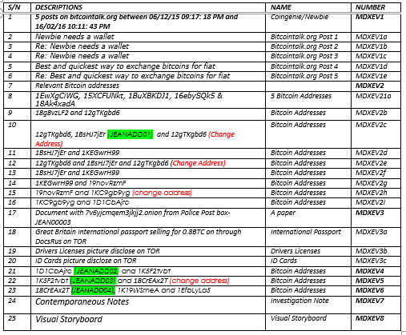
EXHIBIT NUMBER AND DESCRIPTIONS

Slide 8
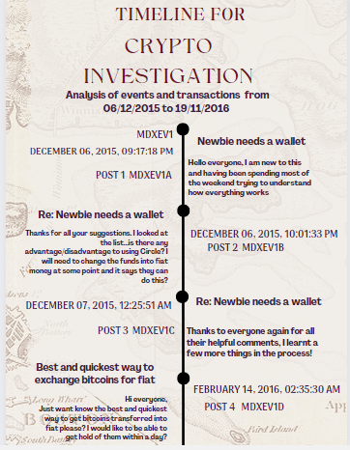
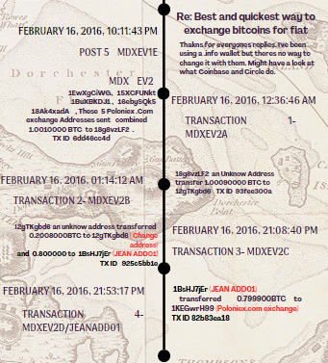
TIMELINE OF THE EVENTS

Slide 9
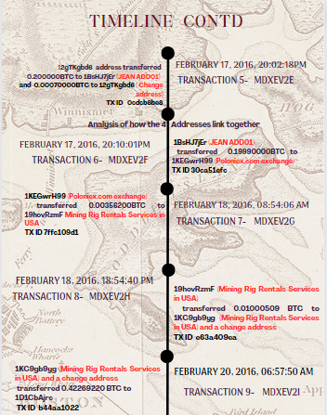
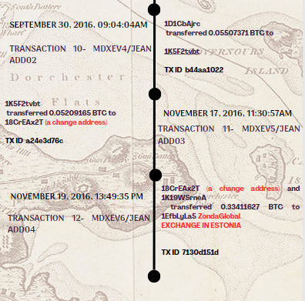
TIMELINE OF THE EVENTS CONTINUED

Slide 10
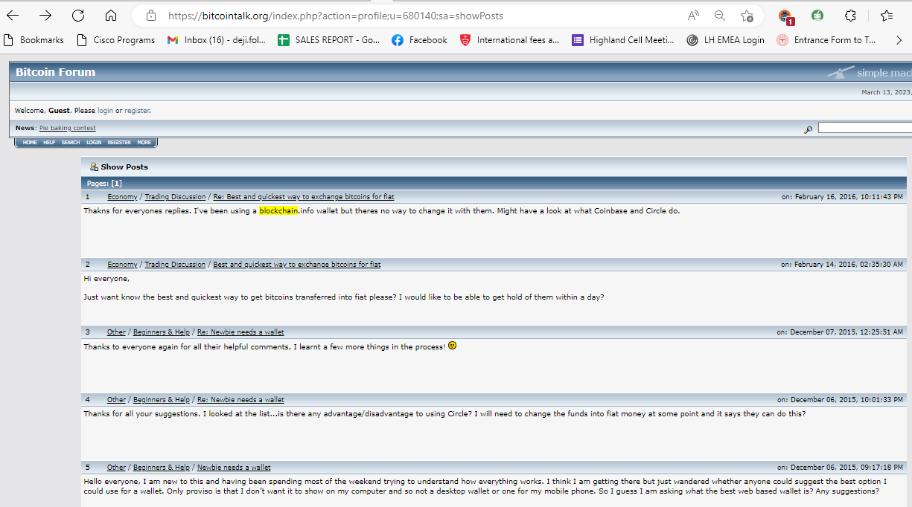
PRESENTING THE EVIDENCE: EXHIBIT MDXEV1 - COINGENIE
This is a coded username of an account belonging to the bitcoin forum (bitcointalk.org), registered on December 06,2015, 07:23:58 PM. It had only five posts and the last activity was on 1st August 2016, 09:04:08 PM.
The discussion was about a newbie (an inexperienced newcomer) to bitcoin forum who needed a wallet and wanted to know the best and quickest way to exchange bitcoin for a fiat, these sequential 5 posts have been captured as exhibit MDXEV1a to MDXEV1e.

Slide 11
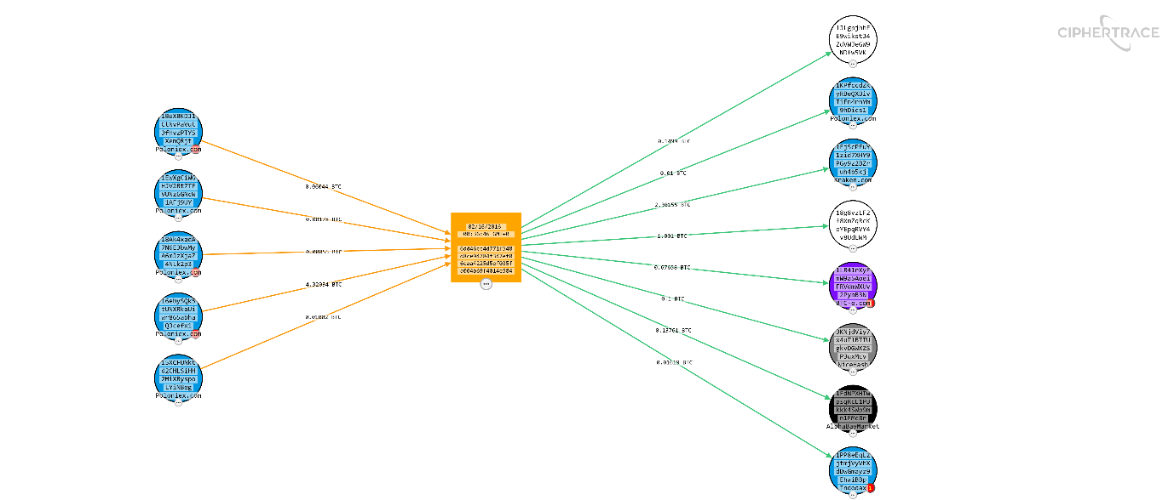
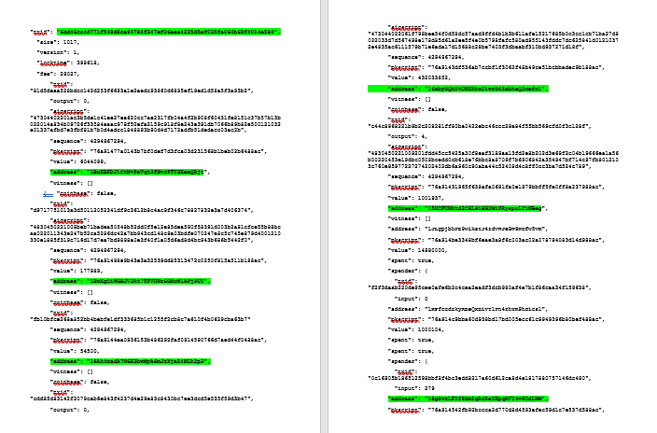
EXHIBIT MDXEV2- RELEVANT BITCOIN ADDRESSES EXHIBIT MDXEV2A- FIRST TRANSACTION
This is the starting point of the transactions. There are 5 addresses that transferred 1.00100000BTC to 18g8vzLF2. They all belong to Poloniex exchange in Panama.
This information was verified on blockchain.com, chain.so, bitcoinwhoswho.com and JSON

Slide 12
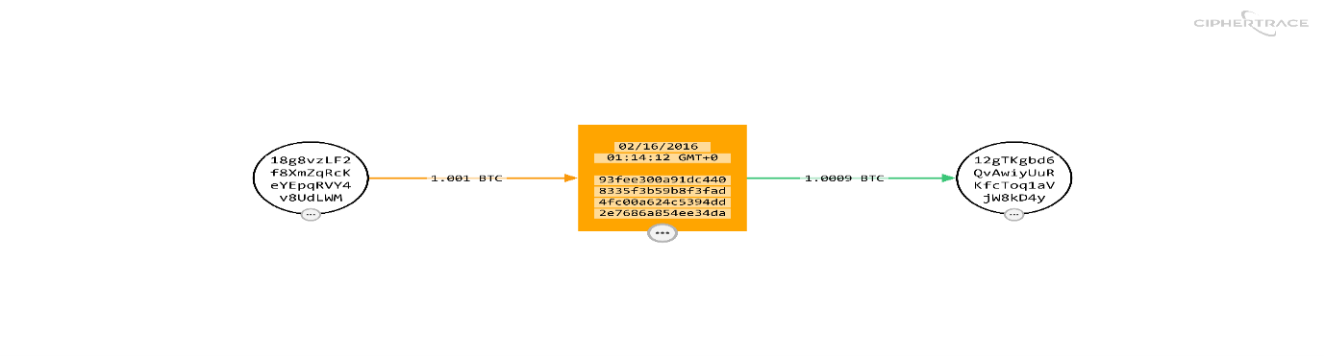
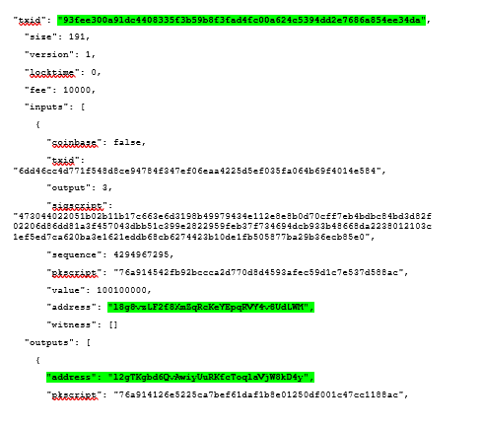
EXHIBIT MDXEV2B- SECOND TRANSACTION
MDXEV2b with Bitcoin address 18g8vzLF2 transferred 1.00090000BTC to 12gTKgd6 from the 1.00100000BTC received from exhibit MDXEV2a, the balance of 0.00010000BTC represent the transaction fee.
This information was verified on blockchain.com, chain.so, bitcoinwhoswho.com and JSON.

Slide 13
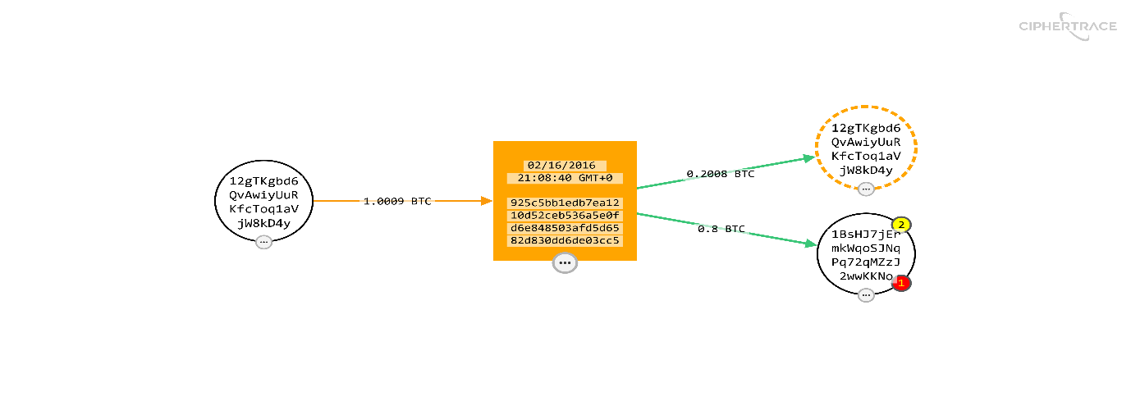
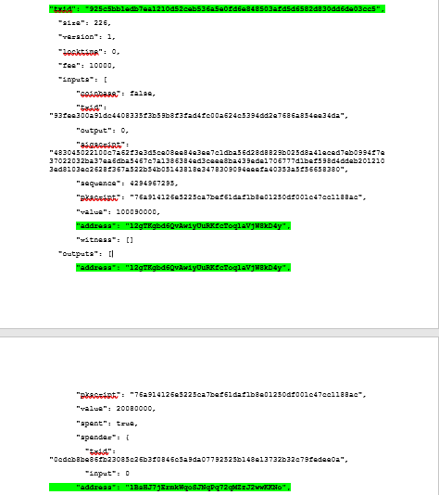
EXHIBIT MDXEV2C- THIRD TRANSACTION
MDXEV2c with Bitcoin address 12gTKgbd transferred 0.80000BTC to 1BsHJ7jEm. This is the bitcoin found on the screwed-up piece of paper at [REDACTED]’s waste collection bin. Also, a change of 0.200800BTC to 12gTKgbd6 (change address) from the 1.00090000BTC received from exhibit MDXEV2b, the balance of 0.00010000BTC represent the transaction fee.
This information was verified on blockchain.com, chain.so, bitcoinwhoswho.com and JSON.

Slide 14
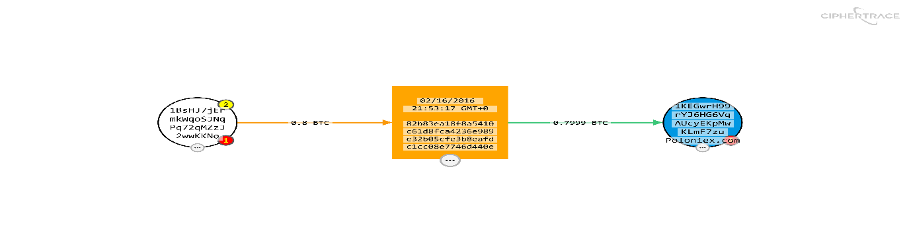
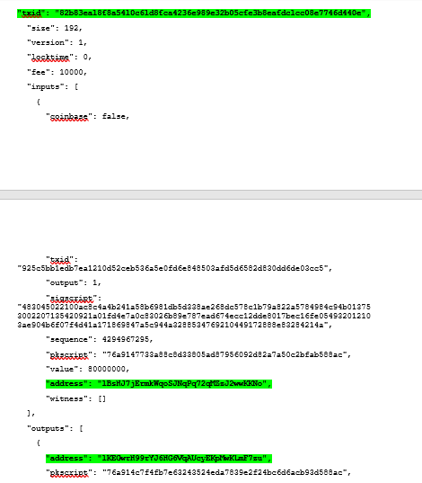
EXHIBIT MDXEV2D/[REDACTED]ADD01- FOURTH TRANSACTION
MDXEV2d/[REDACTED]ADD01 with Bitcoin address 1BsHJ7jEm transferred 0.799900BTC to IKEGwrH99 from the 0.80000BTC received from exhibit MDXEV2c, the balance of 0.00010000BTC represent the transaction fee.
This information was verified on blockchain.com, chain.so, bitcoinwhoswho.com and JSON.

Slide 15
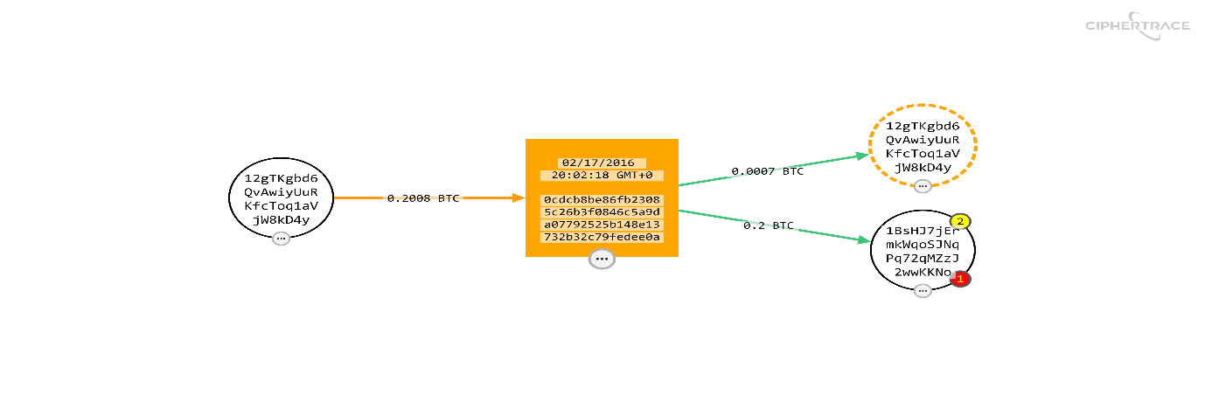
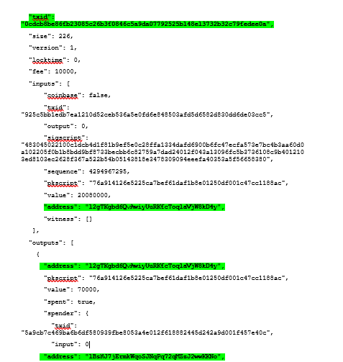
EXHIBIT MDXEV2E- FIFTH TRANSACTION
MDXEV2e with Bitcoin address 12gTKgbd transferred 0.20000BTC to 1BsHJ7jEm. This is the bitcoin found on the screwed-up piece of paper at [REDACTED]’s waste collection bin. Also, a change of 0.000700BTC to 12gTKgbd6 (change address) from the 0.20080000BTC received from exhibit MDXEV2d, the balance of 0.00010000BTC represent the transaction fee.
This information was verified on blockchain.com, chain.so, bitcoinwhoswho.com and JSON.

Slide 16
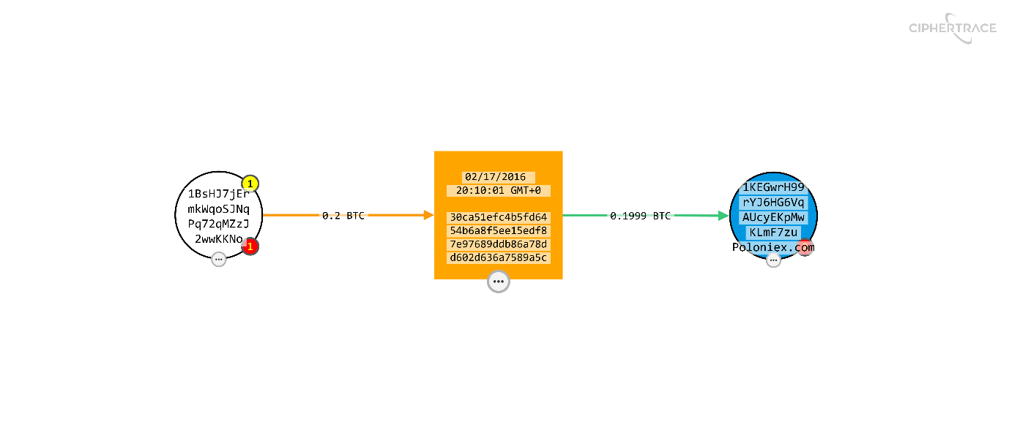
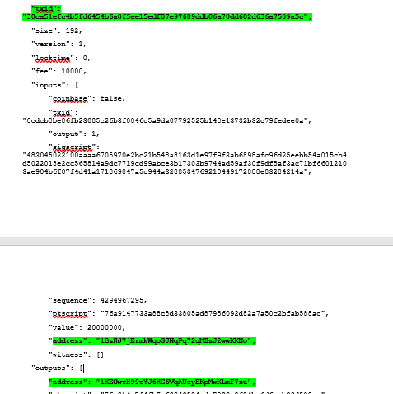
EXHIBIT MDXEV2F- SIXTH TRANSACTION
MDXEV2f/[REDACTED]ADD01 with Bitcoin address 1BsHJ7jEm transferred 0.199900BTC to IKEGwrH99 from the 0.20000BTC received from exhibit MDXEV2e, the balance of 0.00010000BTC represent the transaction fee.
This information was verified on blockchain.com, chain.so, bitcoinwhoswho.com and JSON.

Slide 17
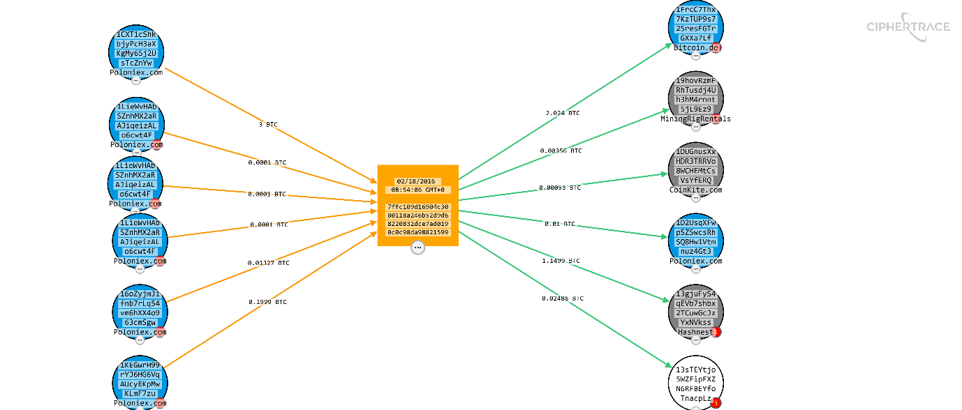
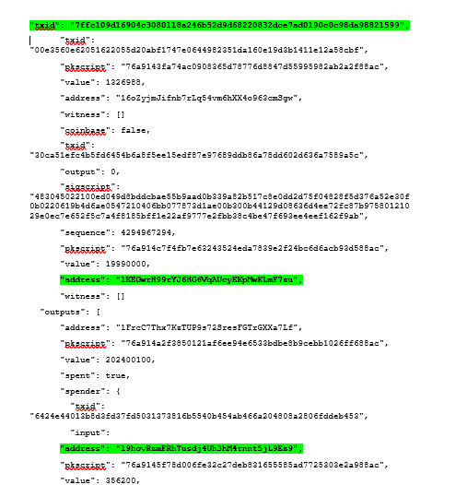
EXHIBIT MDXEV2G- SEVENTH TRANSACTION
MDXEV2g with Bitcoin address IKEGwrH99 transferred 0.00356200BTC to19hovRzmF from the 0.19990000BTC received from exhibit MDXEV2f, the balance of 0.00010000BTC represent the transaction fee.
This information was verified on blockchain.com, chain.so, bitcoinwhoswho.com and JSON.

Slide 18
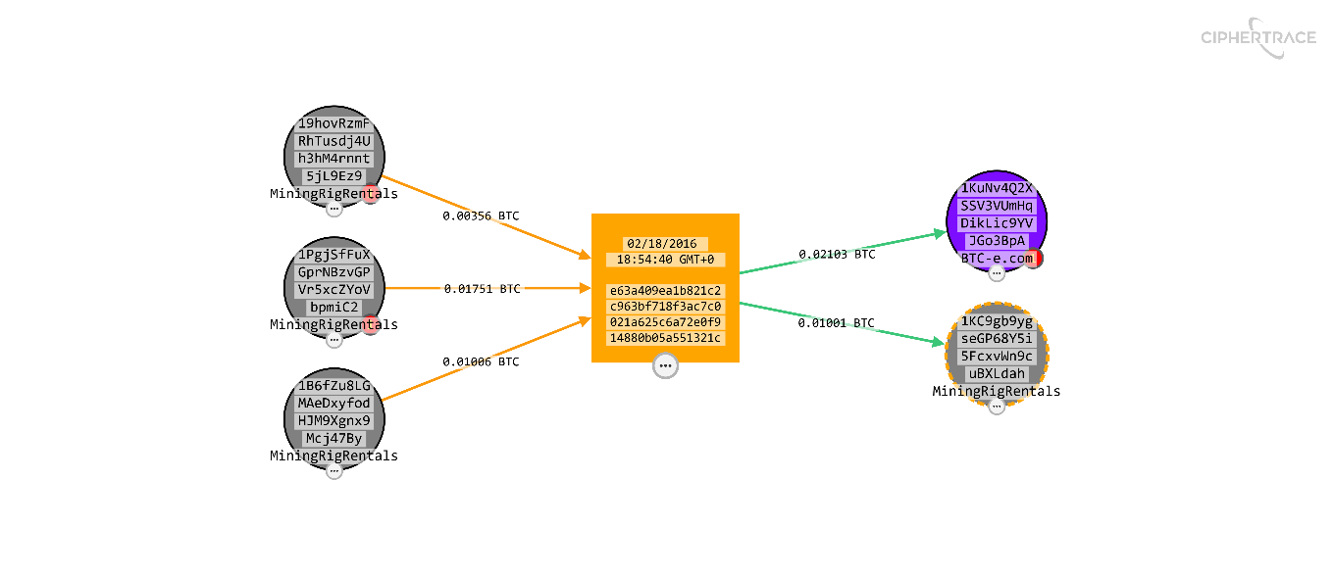
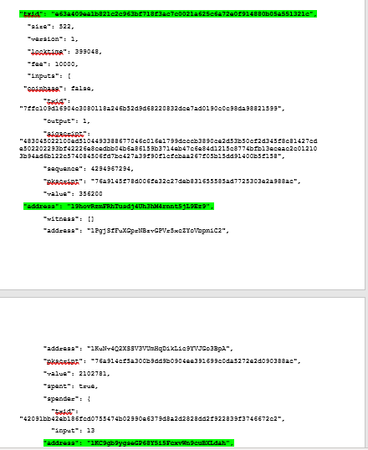
EXHIBIT MDXEV2H- EIGHTH TRANSACTION
MDXEV2h with Bitcoin address 19hovRzmF transferred 0.01000509BTC to 1KC9gb9yg a change address, from the 0.003562BTC received from exhibit MDXEV2g, the balance of 0.00010000BTC represent the transaction fee.
This information was verified on blockchain.com, chain.so, bitcoinwhoswho.com and JSON.

Slide 19
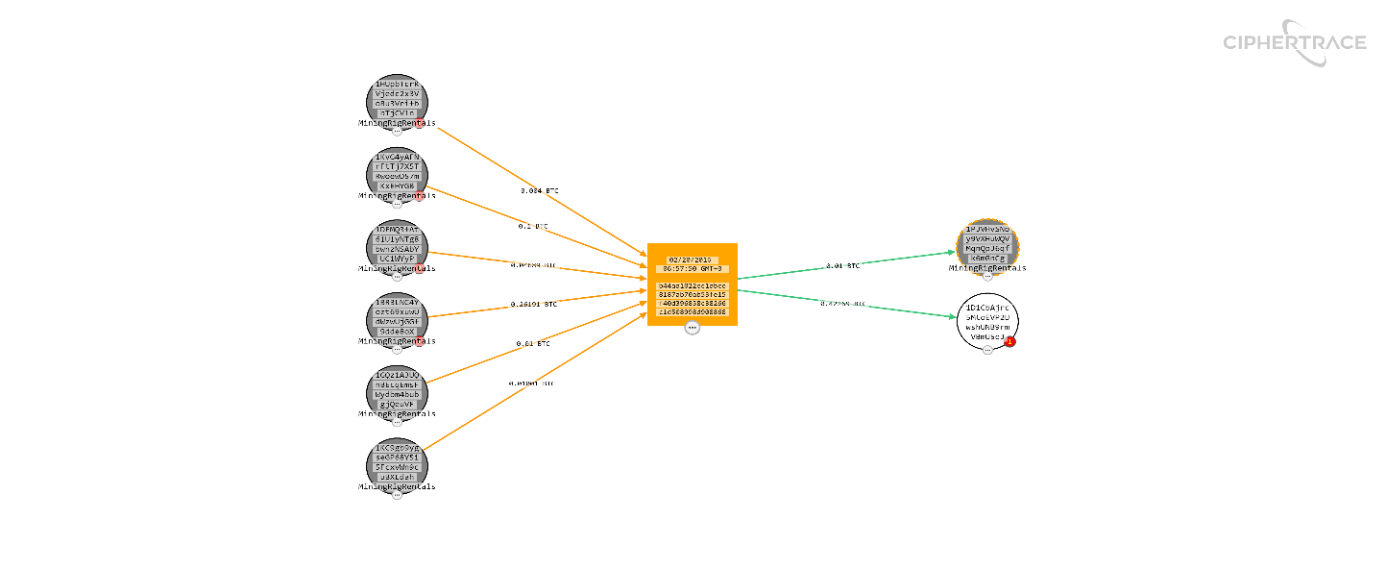
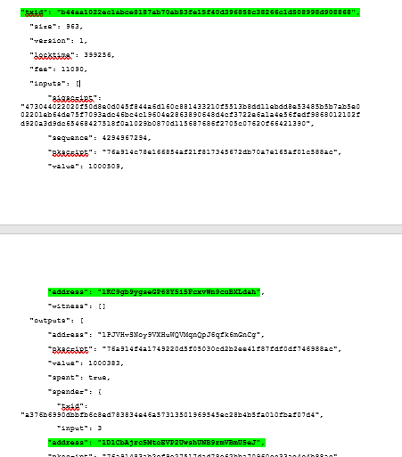
EXHIBIT MDXEV2I- NINETH TRANSACTION
MDXEV2i with Bitcoin address 1KC9gb9yg previously a change address together with other 5 inputs transferred 0.42269220BTC to 1D1CbAjrc (which is one the 3 new Bitcoin addresses from [REDACTED]) from the 0.01000509BTC received from exhibit MDXEV2h, the balance of 0.00011090BTC represent the transaction fee.
This information was verified on blockchain.com, chain.so, bitcoinwhoswho.com and JSON.

Slide 20
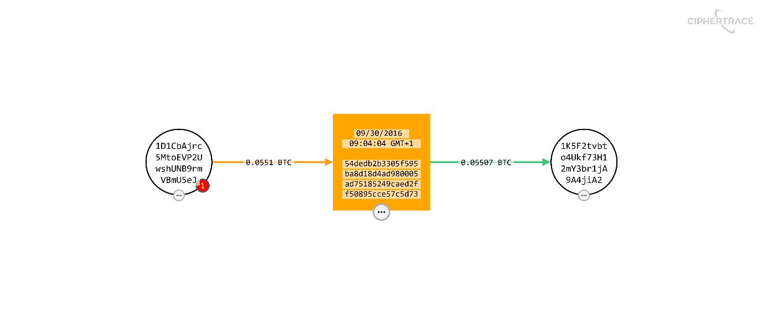
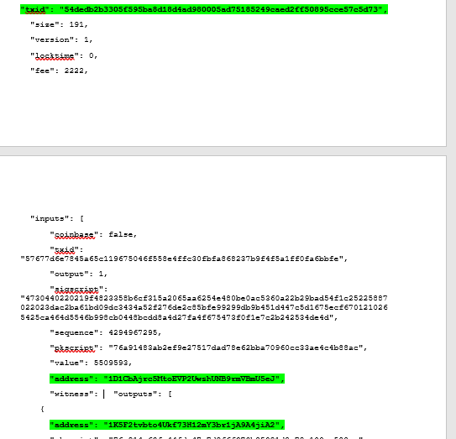
EXHIBIT MDXEV4/[REDACTED]ADD02- TEN TRANSACTION
MDXEV4/[REDACTED]ADD02 with Bitcoin address 1D1CbAjrc transferred 0.05507371BTC to 1K5F2tvbt from the 0.05509593BTC received from exhibit MDXEV2i, the balance of 0.00002222BTC represent the transaction fee.
This information was verified on blockchain.com, chain.so, bitcoinwhoswho.com and JSON.

Slide 21
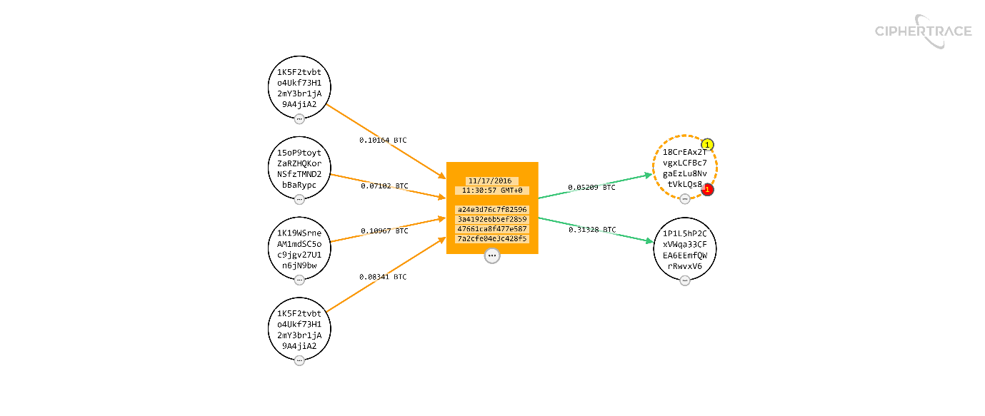
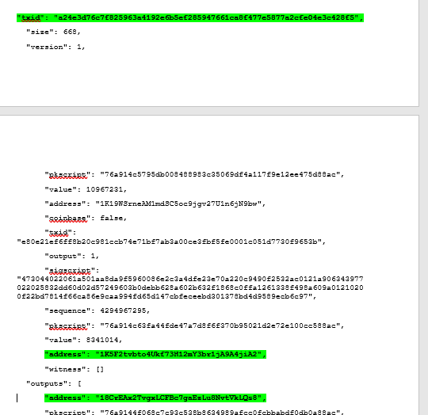
EXHIBIT MDXEV5/[REDACTED]ADD03- ELEVENTH TRANSACTION
MDXEV5/[REDACTED]ADD03 with Bitcoin address 1K5F2tvbt transferred 0.05209165BTC to 18CrEAx2TBTC (A change address) from the 0.18504521BTC (0.10163507+ 0.08341014) received from exhibit MDXEV4/[REDACTED]ADD02, the balance of 0.00036850 BTC represent the transaction fee.
This information was verified on blockchain.com, chain.so, bitcoinwhoswho.com and JSON.

Slide 22
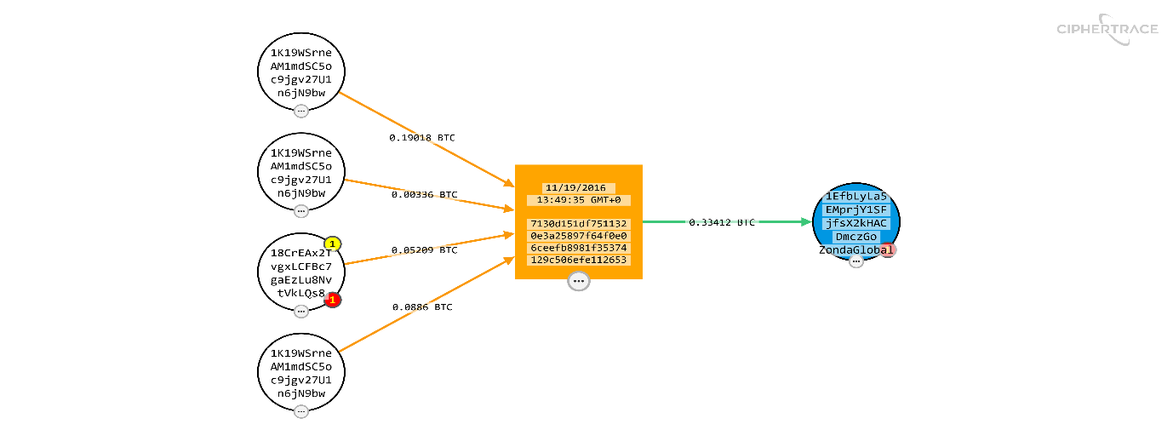
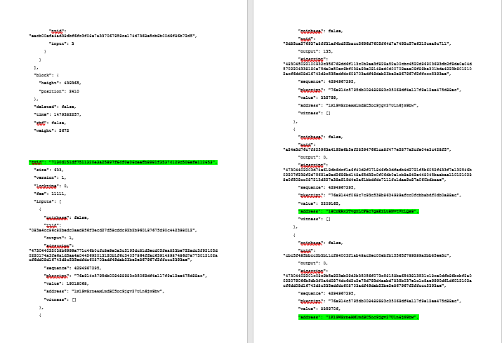
EXHIBIT MDXEV6/[REDACTED]ADD04- TWELFTH TRANSACTION
MDXEV6/[REDACTED]ADD04 with Bitcoin address 18CrEAx2T BTC (A change address) and 1K19WSrneA BTC transferred 0.33411627 BTC to 1EfbLyLa5 from the 0.05209165 BTC received from exhibit MDXEV4/[REDACTED]ADD02, the balance of 0.00011111 BTC represent the transaction fee.
This information was verified on blockchain.com, chain.so, bitcoinwhoswho.com and JSON.

Slide 23
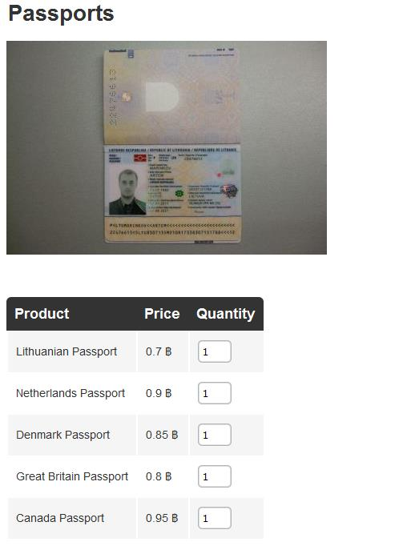
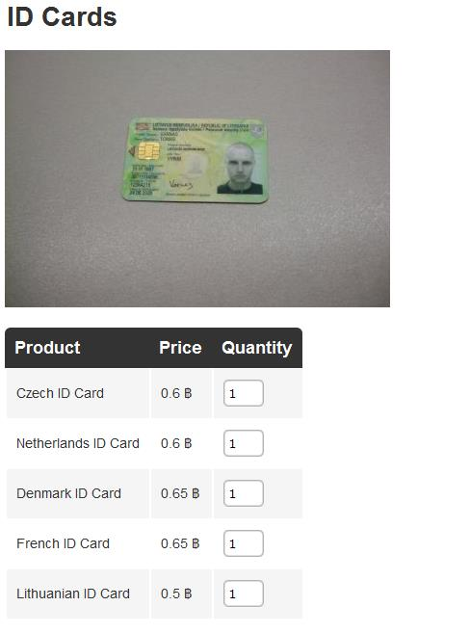
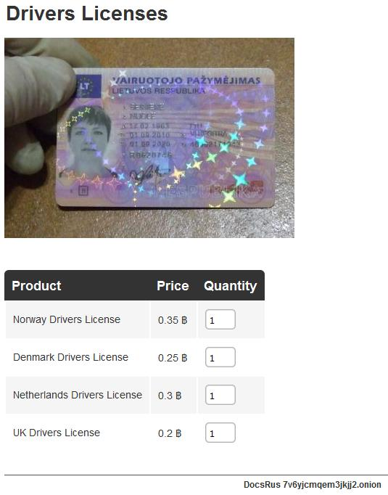
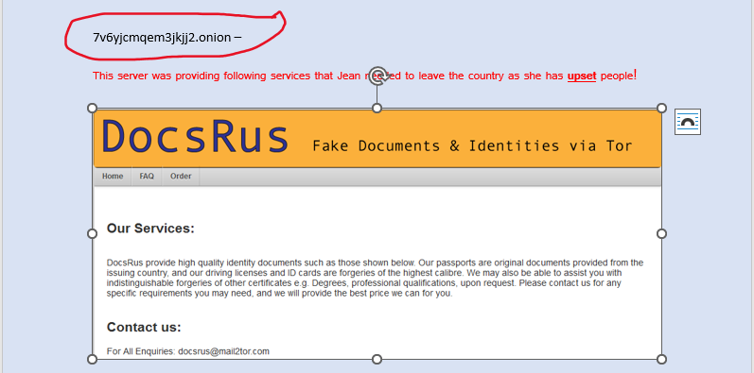
EXHIBIT MDXEV3- 7V6YJCMQEM3JKJJ2.ONION
Exhibit MDXEV3 was paper evidence left in Police Post Box by a male wearing a hoodie and balaclava
Mail2tor was identified as an existing domain name registered in May 2017 through whatsmyname.app but no information about Docrus@mail2tor.com.
TOR allows user's identity to be hidden and subsequently, 7v6yjcmqem3jkjj2.onion could not be found. (TorProject, 2023).
DocsRus provided fake documents and identities via TOR, such as a UK passport with a cost of 0.8B for a unit, UK driver's license with 0.2B for one quantity, ID Cards with quantity, price and country without United Kingdom, however none provided dates or evidence of transaction.

Slide 24
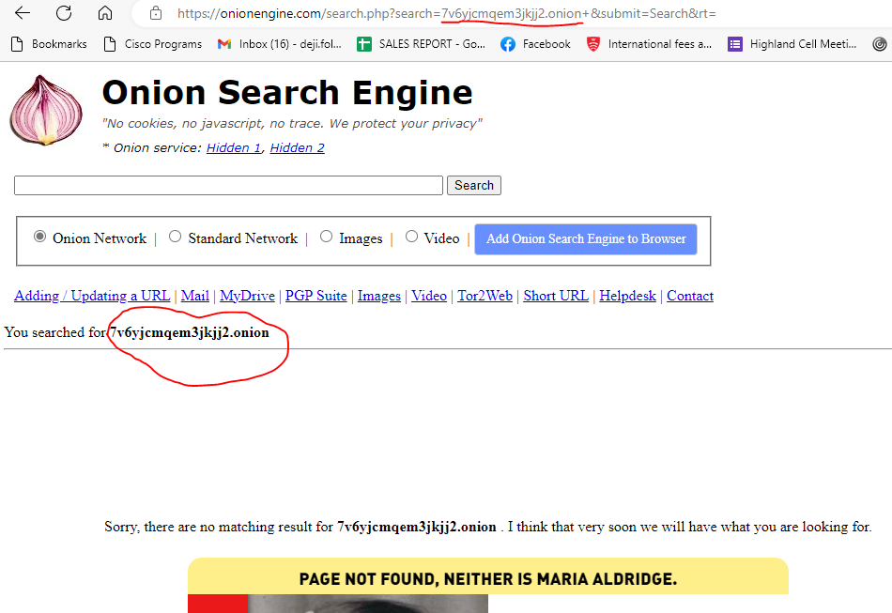
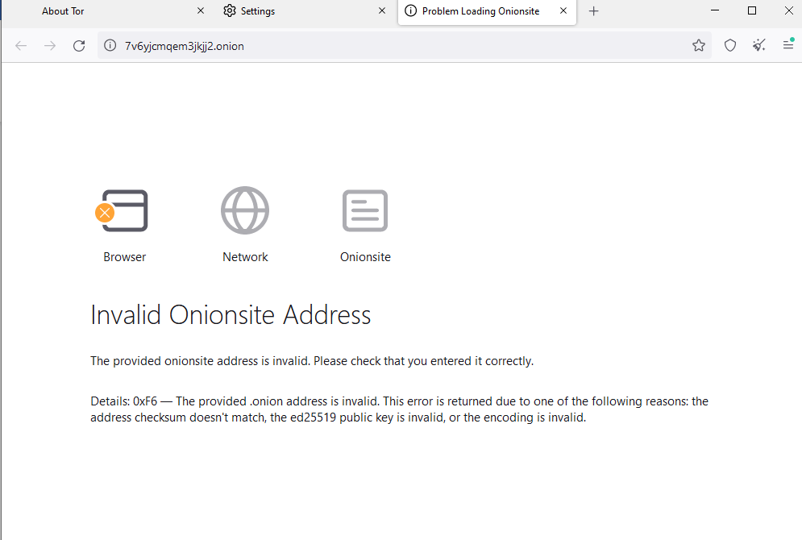
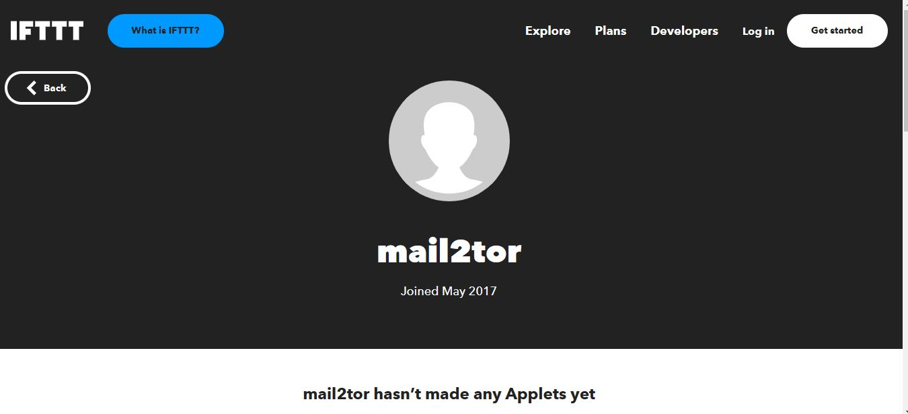
EXHIBIT MDXEV3- 7V6YJCMQEM3JKJJ2.ONION CONTINUED

Slide 25
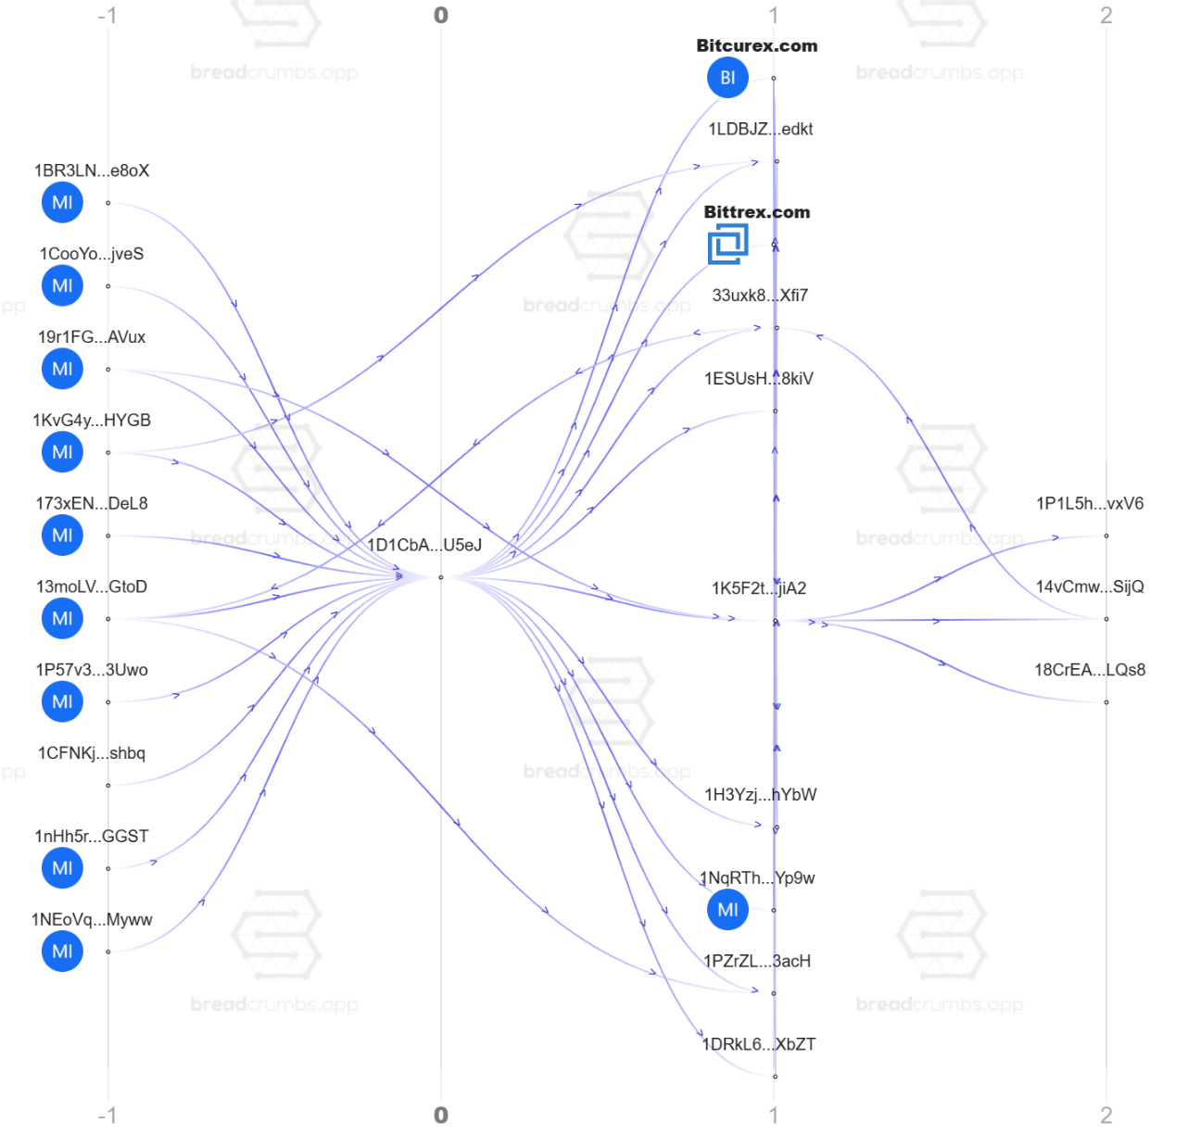
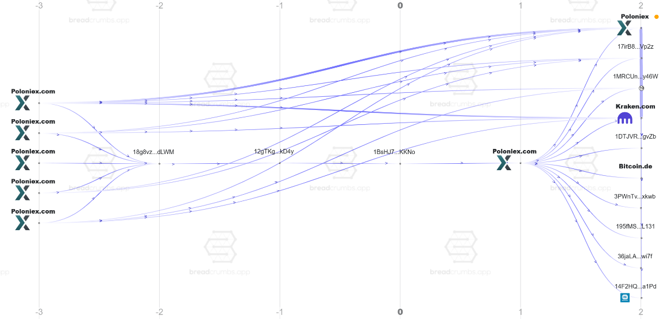
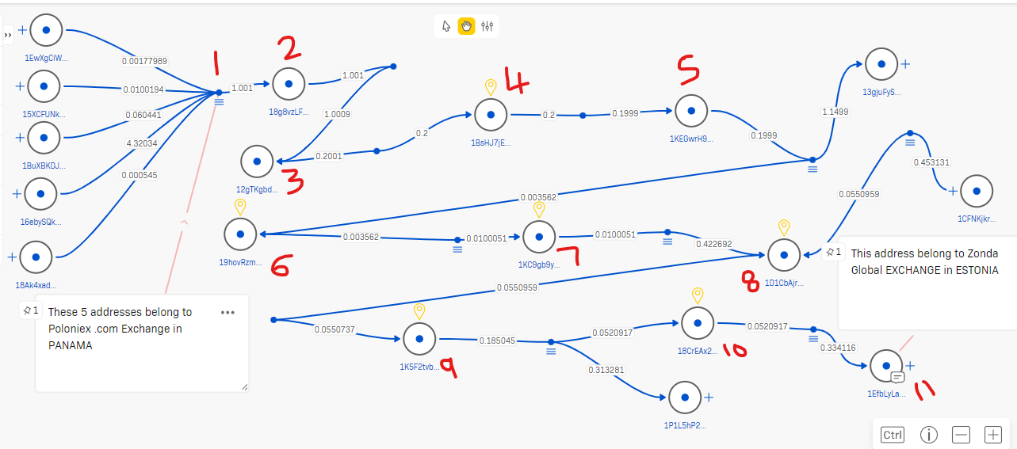
INDIRECT TRANSACTION CONNECTIONS OF THE 4 BITCOIN ADDRESSES
The four bitcoin addresses have an indirect transactional connections via the attached seven transaction identities (TX IDs)

Slide 26
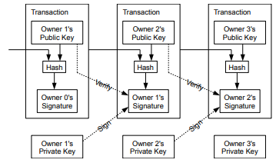
OVERVIEW OF BITCOIN
What is Bitcoin?
Bitcoin was created to function as peer-to-peer electronic cash.
Bitcoin is a chain of digital signatures that transfers ownership from one owner to the next by digitally signing a hash of the previous transaction and the public key of the next owner. (Nakamoto, 2008).
Bitcoin is not a physical currency, but rather a ledger of all transactions between Bitcoin addresses. These records are updated by the Bitcoin network participants and shared across nodes as balances increase and decrease. (Nakamoto, 2008).
Public and private keys
To send Bitcoin, someone must have access to the public and private keys associated with the amount of bitcoin they want to send.
A public key (address) and private key (password) authorize bitcoin to be sent elsewhere.
Public keys are randomly generated sequences of letters and numbers, similar to email addresses (Nakamoto, 2008).
What is Blockchain?
A Blockchain ledger is a digital, distributed, and decentralized ledger that records transactions across a global network of computers.
It is a linear chain of blocks that contains data in the form of coding that is organized in a chronological manner.

Slide 27
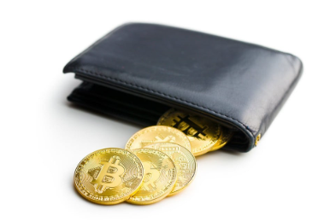
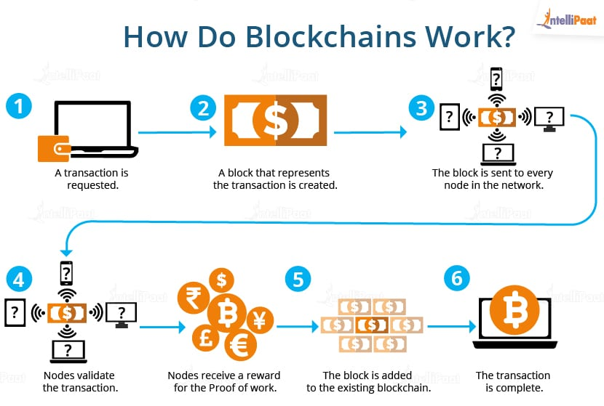
OVERVIEW OF BITCOIN CONTINUED
What is a Blockchain Wallet?
Blockchain Wallets are computer programs that allow users to monitor and transact cryptocurrencies, with transactions recorded in the blockchain and private and public keys stored in the wallet store. (Raj, 2023)
Blockchain Sign up is done first and then the blockchain wallet login is required. These interactions are necessary to allow users to purchase or sell cryptocurrencies (Raj, 2023)
Blockchains use a distributed consensus model to validate and add blocks, allowing them to function as distributed ledgers without central authority.
If a consensus is achieved, the block is accepted into the ledger and the new block containing data is added, if not, it is denied. This makes the blockchain transaction extremely secure. (Raj, 2023)
Blockchain transaction process

Slide 28
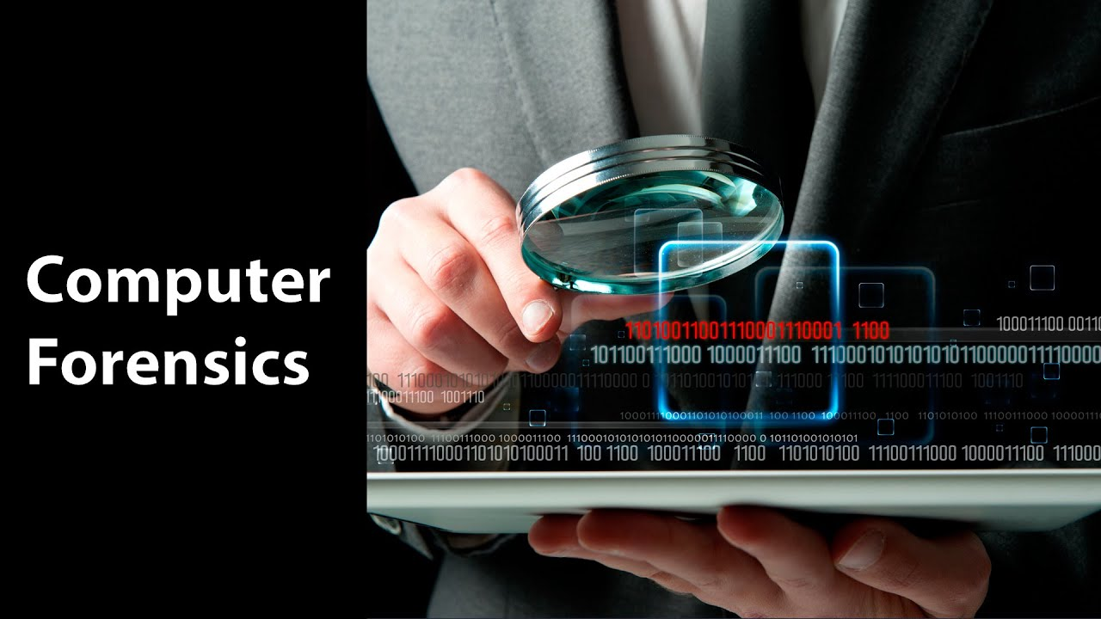
FORENSIC LIMITATIONS OF CONDUCTING CRYPTOCURRENCIES INVESTIGATIONS
May require court order to obtain evidence
Delays in obtaining evidence can lead to the perpetrator destroying or tampering with it, and court orders can be difficult to obtain.
Can be expensive
Computer forensics is expensive and requires specialized equipment and software, and can take a long time to complete.
Requires specialized skills and knowledge
It is a process that uses specialised skills to collect, examine and report digital evidence to investigate crimes, and solve mysteries.
Evidence can easily be destroyed or tampered with
Suspects may delete files or destroy hard drives to prevent investigators from finding incriminating evidence, even if recovered (Mabry, 2022).
Time-consuming process
Computer forensics can take days or weeks to collect and analyse data, making it difficult to solve crimes.

Slide 29
SUMMARY OF FINDINGS AND CONCLUSION
Did Jean commit sensitive documents exfiltration? No evidence of support from her previous employers.
Was any investigator paid to thwart the previous investigation? No evidence to support this claim by Jean.
Is there any link between ownership of Coingenie profile and Jean? There was no evidence to proof that Jean is the owner.
Is there any connection between Bitcoin address 1BsHJ7jEr and Jean? No provable connection.
Is there any connection between Jean and 7v6yjcmqem3jkjj2.onion server? No provable connection.
Is there any link between Jean and the fake documents on DocsRus? No provable connection.
Was Jean Paid to cover up for a wanted Criminal? No evidence to support this claim by detective Holmes.
Is there any connection between Jean and the 3 new Bitcoin addresses? No provable connection.
Are there any connections among the 4 Bitcoin addresses? There is only indirect transactional links among them.
Detectives Holmes and team can subpoena the discovered exchanges and company for KYC of customers’ addresses traced to them.
In conclusion, all evidences presented above could be classified as men’s rea which are not enough to convict a suspect and there is need for further investigations.

Slide 30


FUTURE INVESTIGATION AVENUES
Obtain a warrant to search her computer, cell phones and other digital footprints to help with the investigation.
Jean's written statement can be used as evidence in court in accordance with section 9 of criminal justice Acts 1967. (CPS,1967)
Get legal means to request user’s KYC from the ISP that owns the discovered IP addresses
Run a fingerprint analysis on the paper with 1BsHJ7jE address and the other with 7v6yjcmq.onion
Blockonomics.com explorer’s address watcher and subscribe to transaction notification email can be used to monitor further transactions occurrence on the 4 bitcoins addresses

Slide 31
References
https://bitcointalk.org/index.php?action=profile;u=680140 (no date) Available at: https://bitcointalk.org/index.php?action=profile;u=680140 (Accessed: March 19, 2023).
Bitcoin block explorer and API (no date) Bitcoin Block Explorer & API - SoChain. Available at: https://chain.so/BTC (Accessed: March 19, 2023).
Blockchain Explorer - Bitcoin Tracker & More | blockchain.com (no date). Available at: https://www.blockchain.com/explorer (Accessed: March 19, 2023).
Blockchain Investigation Tool (no date) Breadcrumbs. Available at: https://www.breadcrumbs.app/reports/5644 (Accessed: March 19, 2023).
Chain of custody (2023) Wikipedia. Wikimedia Foundation. Available at: https://en.wikipedia.org/wiki/Chain_of_custody (Accessed: March 15, 2023).
Ciphertrace Inspector (no date). Available at: https://ciphertrace.com/wp-content/uploads/2020/05/Datasheet_CipherTrace_Inspector_Updated02272023.pdf (Accessed: March 15, 2023).
https://www.cps.gov.uk/legal-guidance/admitting-evidence-under-sections-9-and-10-criminal-justice-act-1967
Crystal. Available at: https://explorer.crystalblockchain.com/visualization/4i7Vf4rZuyhYQOmn?x=-108.69412994384766&y=-119.4714126586914&k=0.9999284148216248 (Accessed: March 19, 2023).
Free design tool: Presentations, video, social media | CANVA (no date). Available at: https://www.canva.com/ (Accessed: March 19, 2023).
Mabry, K.L. (2022) Computer forensics: 5 advantages and disadvantages, SMB Security Operation Center. Available at: https://sentreesystems.com/pros-and-cons-of-computer-forensics/#:~:text=The%20advantages%20are%20that%20it,and%20it%20can%20be%20expensive. (Accessed: March 21, 2023).
Nakamoto, S., 2008. Bitcoin: A peer-to-peer electronic cash system. Decentralized business review, p.21260.
Raj, R. (2023) How does blockchain work? - blockchain transaction - intellipaat, Intellipaat Blog. Available at: https://intellipaat.com/blog/tutorial/blockchain-tutorial/how-does-blockchain-work/ (Accessed: March 21, 2023).
Track bitcoin (no date) Blockonomics. Available at: https://www.blockonomics.co/blockonomics#/addresswatcher (Accessed: March 23, 2023).
Williams, J. (2012) ACPO Good Practice Guide for Digital Evidence [Preprint].
7v6yjcmqem3jkjj2.Onion+ - onion search engine. Available at: https://onionengine.com/search.php?search=7v6yjcmqem3jkjj2.onion%2B&submit=Search&rt= (Accessed: March 19, 2023).

